Slide 1
Transitioning to Electronic and Open Access: the ETD Program at Caltech
Katherine Johnson
Digital Repositories Coordinating Librarian
California Institute of Technology
kjohnson@library.caltech.edu
(626) 395-6065
Open Access and Digital Repository Forum, San Jose, CA
May 25, 2011

Slide 2
Brief History Of Electronic Theses At Caltech
Where We Came From

Slide 3
ETD Era Begins
1999
Ed Fox of Virginia Tech delivers influential speech at Caltech
Caltech joins NDLTD
2001
Caltech hosts 4th ETD conference
ETD-db software loaded on library servers: CaltechETD
Dean of Graduate Students initiates voluntary submission period
Retrospective scanning of theses begins

Slide 4
Beginnings
2002
Faculty committee and Dean approve mandatory submissions for June graduation
Paper copy remains official copy of record
Library begins theses classes
Systematic retrospective scanning begins
By January 2003
71 “new” theses
300+ “old” scanned theses

Slide 5
Changes & Growth
2007
Electronic copy becomes copy of record
Students no longer required to submit paper copy
2008
Consolidation of digital repository collections becomes necessary
Important considerations for migration:
Need to maintain permanent URLs for old theses to be migrated
Support for thesis workflow and approval process, tracking progress for both staff and students

Slide 6
Changes & Growth
Support for withholding whole, or portions of, theses, pending journal publication or patent application
Ability to stored related documents in a “dark” area visible only to repository administrators
“Notifications” allowing staff to communicate with authors via email
2009
Migration of electronic theses to Eprints platform completed: CaltechTHESIS
First successful deposit by student in October

Slide 7
As of May 24, 2011
6101 theses have been deposited
1663 “new”, by students
4524 “old” scanned, by staff
Only 62 are completely withheld, 1922 are restricted (1871 are 1978+), 115 have mixed availability. All others are publicly available
More than halfway through retrospective scanning project
Coverage years span 1921-2011
Contents heavily PhD-centric, but also include Bachelors’, Masters’, and Engineers’ theses

Slide 8
Navigating The Electronic Thesis Process
The Road to Oz

Slide 9
Acquisitions of Electronic Theses
Theses classes offered regularly, frequency varies
Strictly voluntary, participation relatively high
Covers mechanics of depositing thesis into database, issues of copyright, formatting of text, acceptable file types, and file restriction considerations
Students add new, born digital, theses
Library staff add scanned theses
Priorities for order of scanning
Third-party requests, author requests, anniversary dates
Alumni and Development offices use as PR material

Slide 10
Handling Access Restrictions
Students and advisors decide on accessibility
Default usage agreements and Creative Commons options are provided
Patents, pending publications, startup competiveness affect most decisions
Copyright assistance is often requested
Student content: authored, borrowed
Scanned theses: pre-1978, 1978+

Slide 11
Handling Access Restrictions
Four flavors of access restrictions
Licensing options are built in
Thesis availability and file accessibility work in tandem
Publicly accessible = free to all right away
Restricted to campus = must be within Caltech IP range to access files
Mixed access = separate files attached to thesis record have differing access restrictions
Withheld = completely embargoed
Embargoes changed manually to prevent accidental release

Slide 12
Handling Access Restrictions
Effect on UMI sharing
No theses are sent to UMI until publicly available
Embargoing functionality used for internal documents
Forms : UMI forms, Electronic Thesis Approval forms
Permissions: Copyright letters, release permissions
Source files

Slide 13
Communication is Key
Separate ETD database set up as interoffice communication tool between library and Grad Office
Students receive emails as key status changes are made in their thesis submission record
Classes held regularly, and with greater frequency during periods of high demand
Library guides updated frequently to maintain currency. Student feedback solicited for needed changes
Project management for retrospective scanning

Slide 14
The Outcome
Is it Worth It?

Slide 15
Effect on Use of Original Research
Statistics show effort is definitely worth it
In paper era, 2 uses in lifetime considered “high-use”
Use for electronic copies can be very high for even older material
Generates requests for even un-scanned older theses
High use from outside U.S.
Numbers (April 2011)
49358 website visits from 31,906 unique users. U.S., China, Australia, South Korea were top countries
44991 document file downloads (.pdf, .doc, .ps, .bib, .txt)
5867 supplemental video file downloads (.mov, .avi, .mpg)

Slide 16
CaltechTHESIS Demonstration
Behind the Scenes

Slide 17
CaltechTHESIS Screenshots

Slide 20
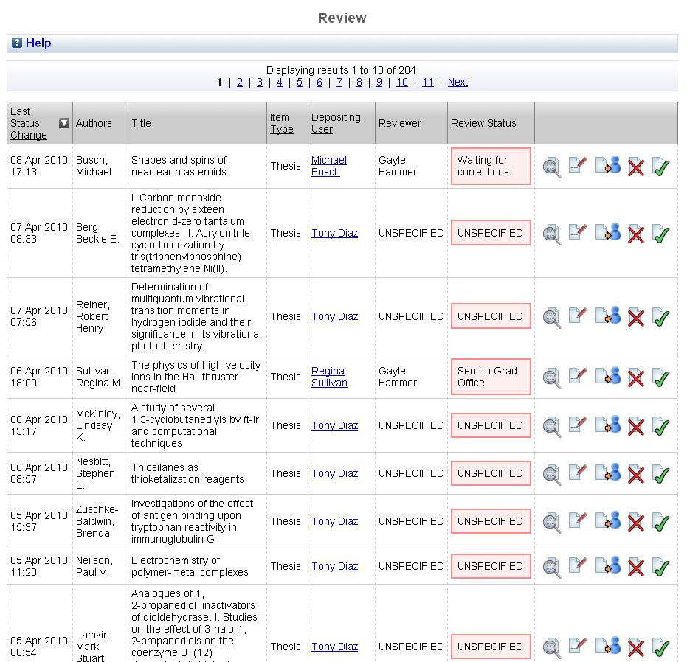

Slide 21
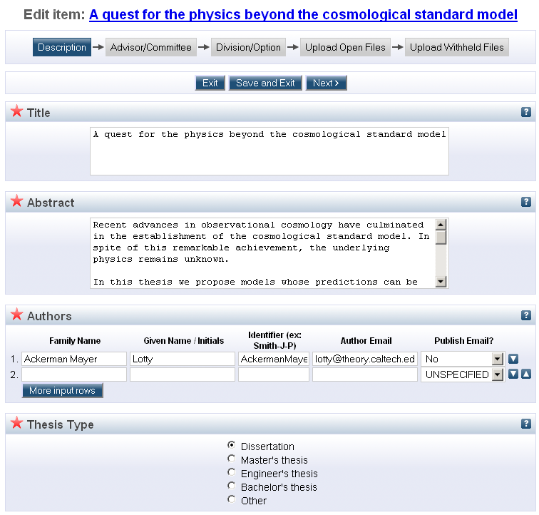

Slide 22
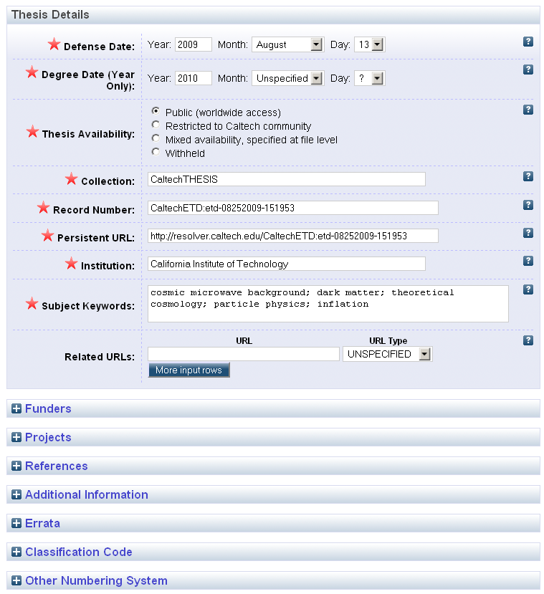

Slide 23
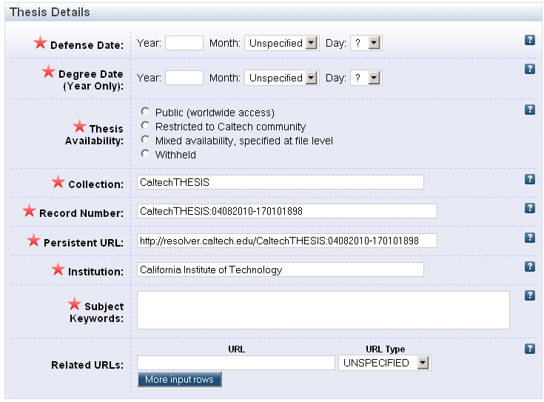
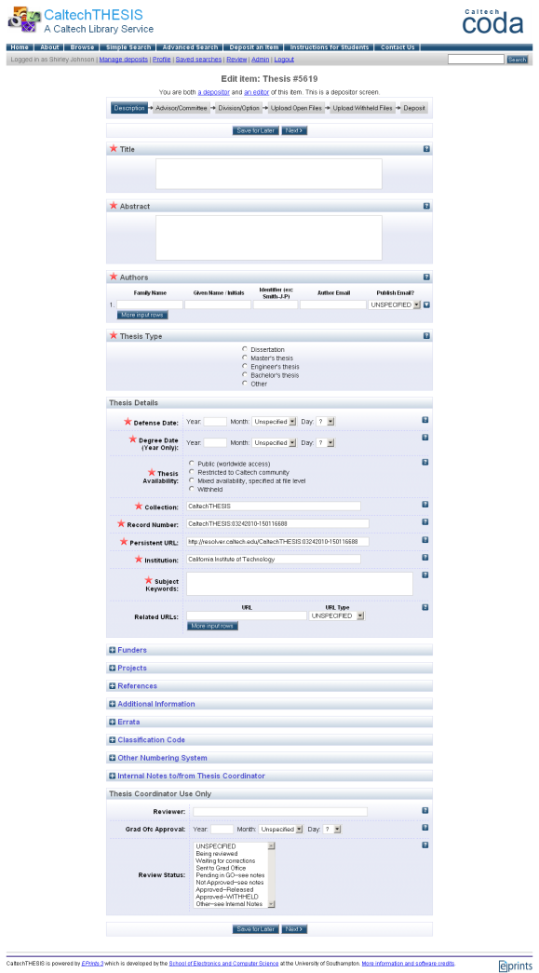

Slide 24
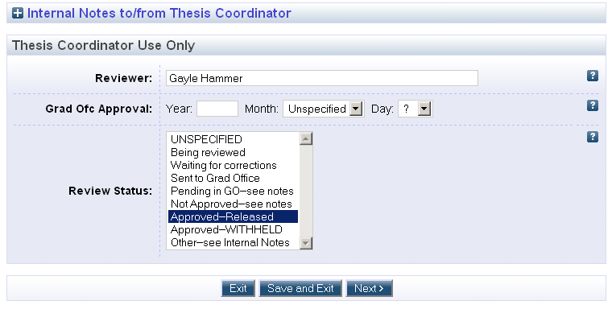

Slide 25
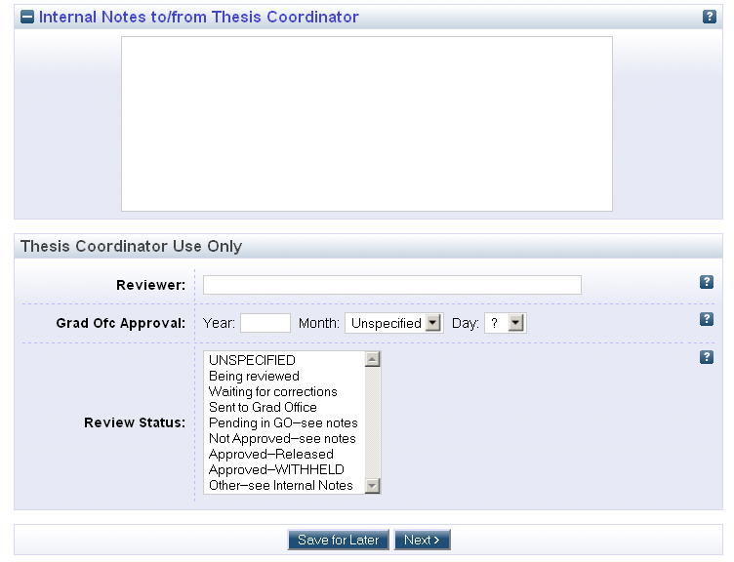

Slide 26
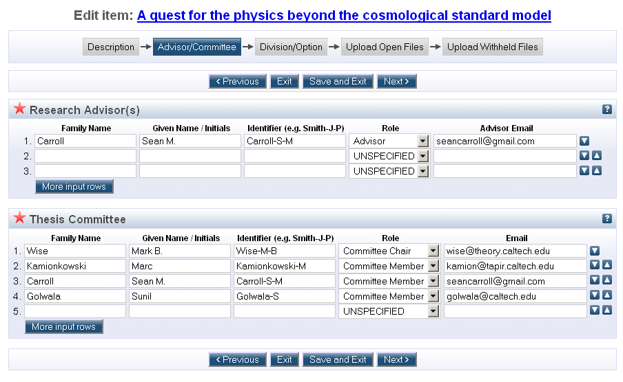

Slide 27
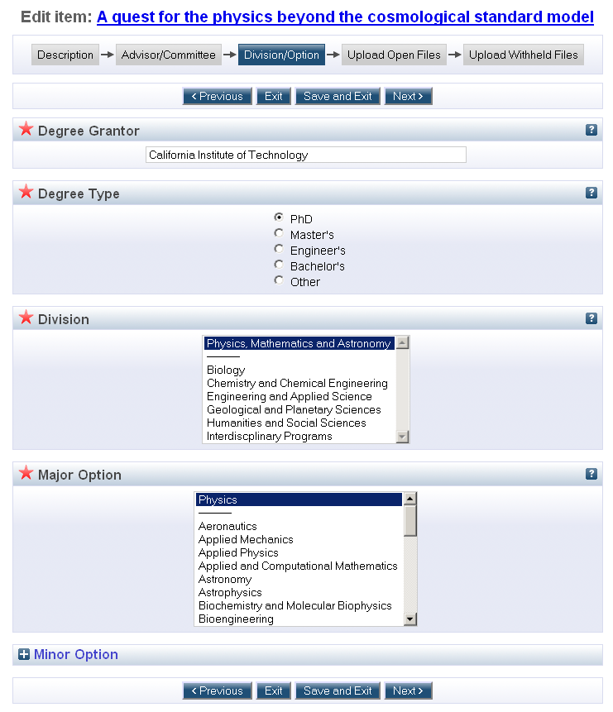

Slide 28
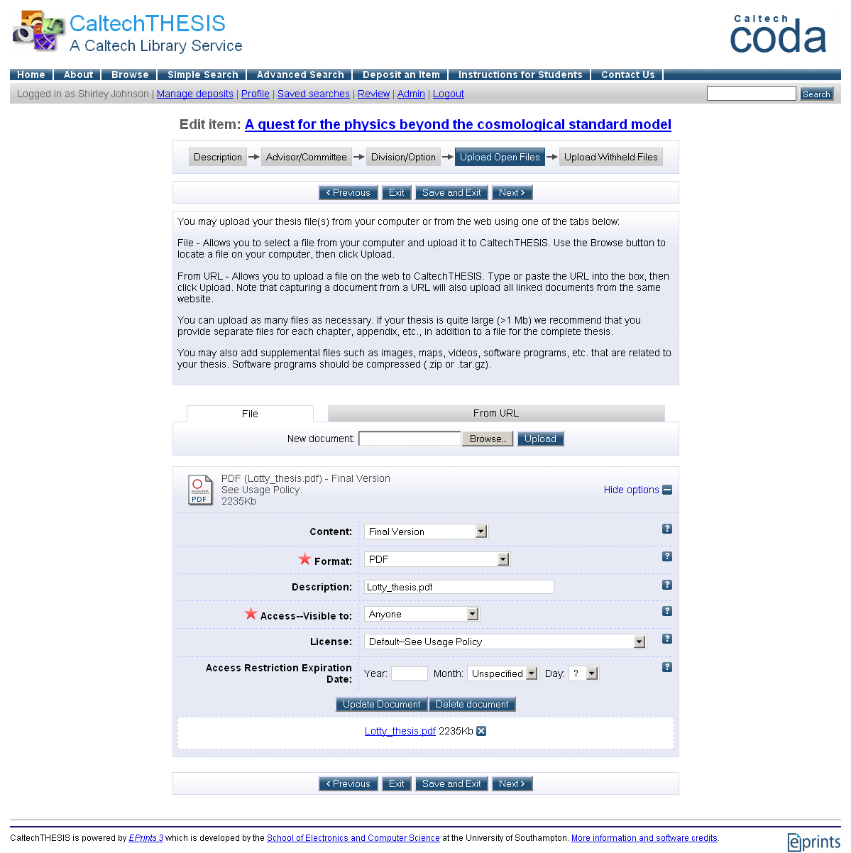
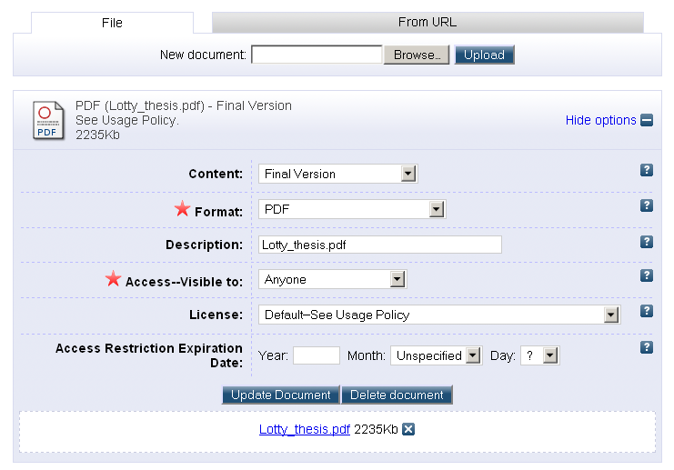

Slide 29
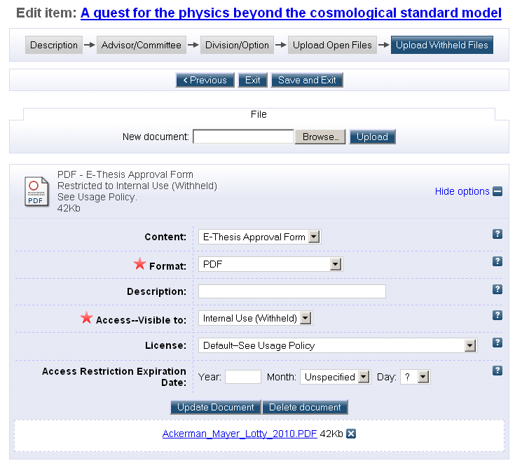
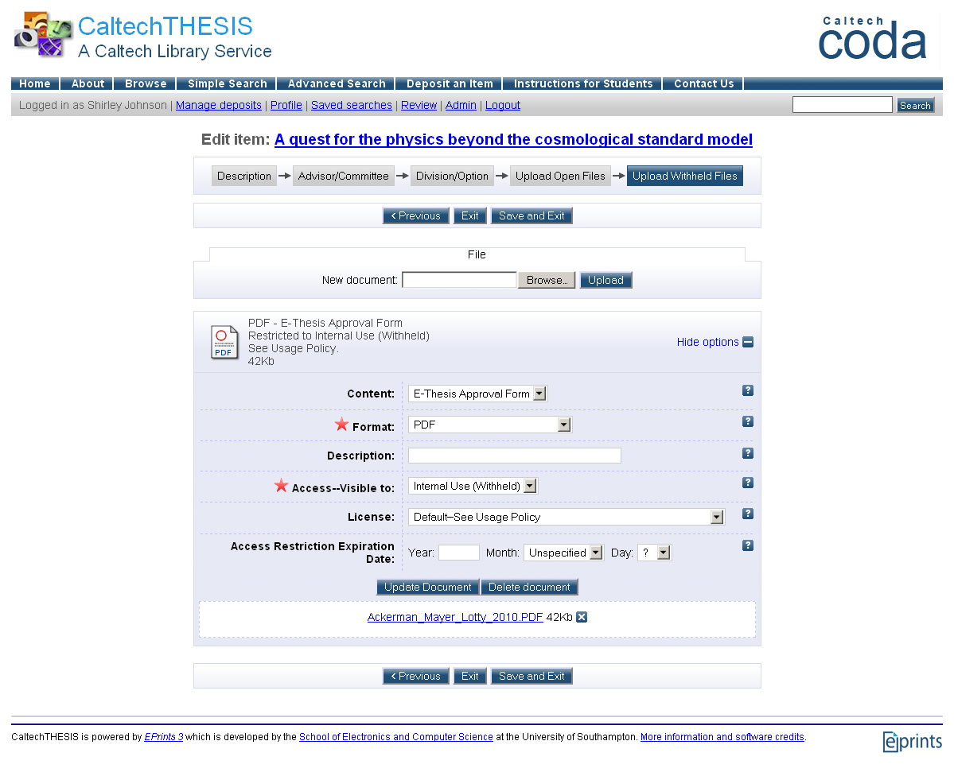

Slide 30
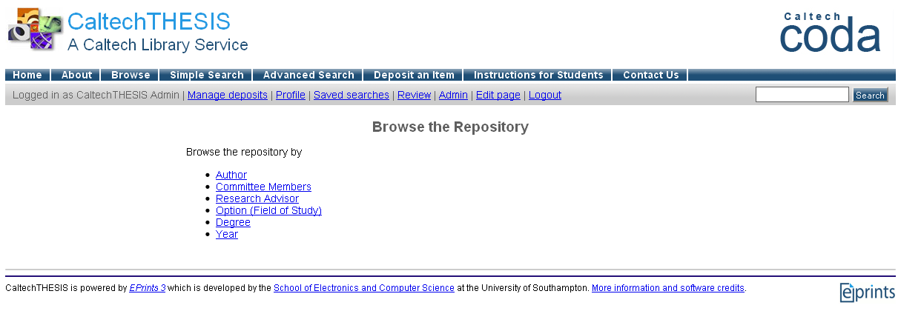

Slide 31
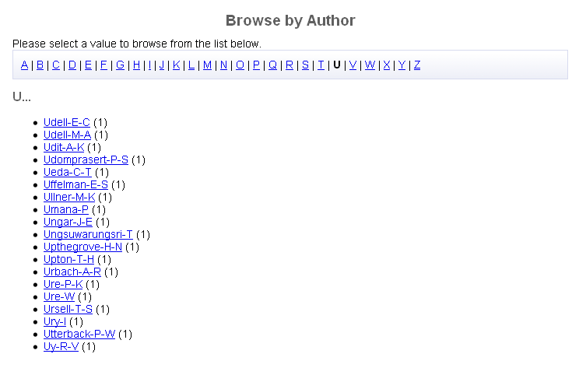

Slide 32
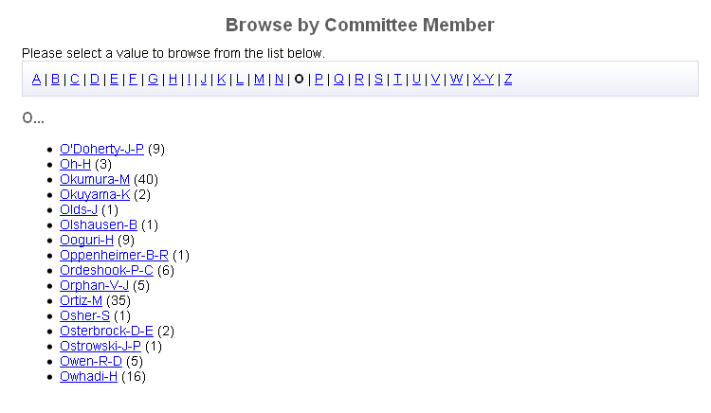

Slide 33
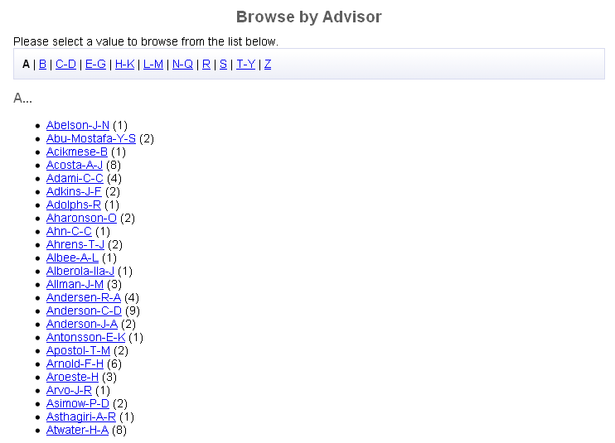

Slide 34
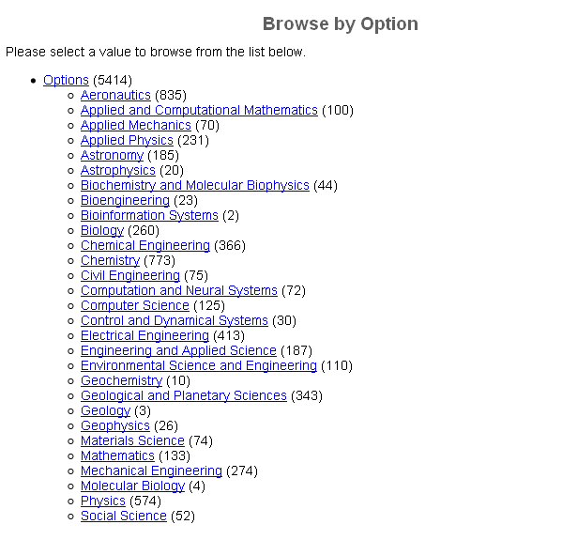

Slide 36
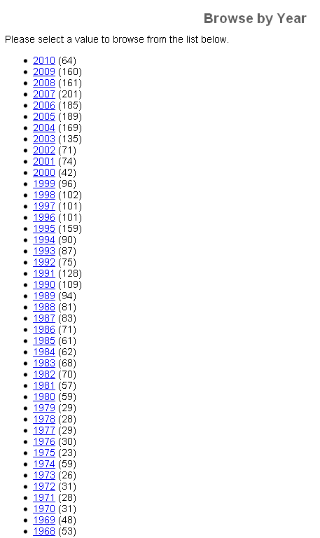
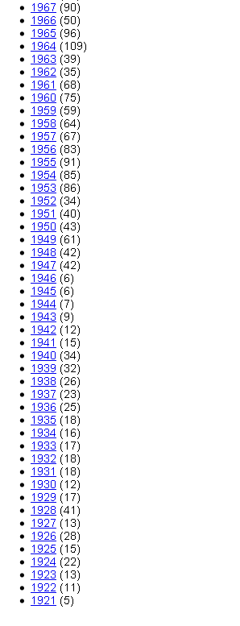

Slide 37
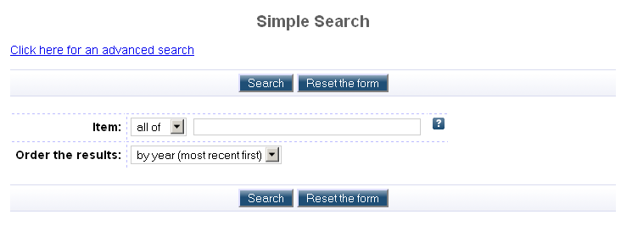

Slide 38
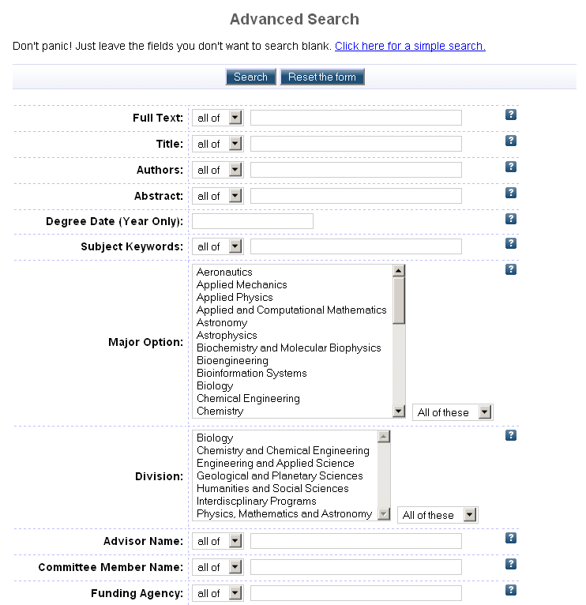
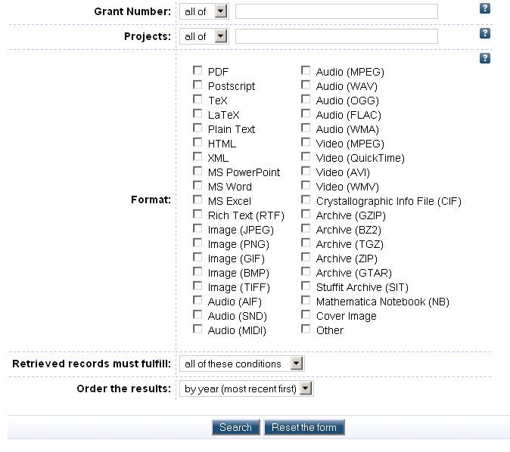

Slide 39
ETD-Grad Office Approval Screenshots

Slide 40
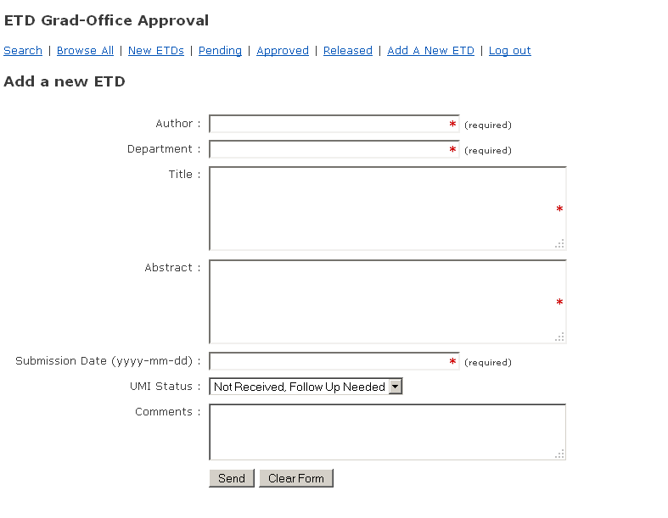

Slide 41
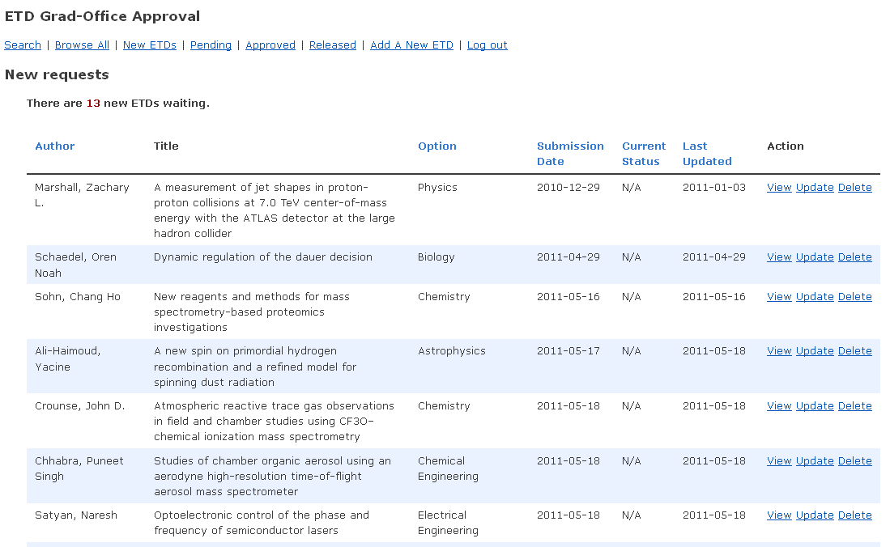

Slide 42
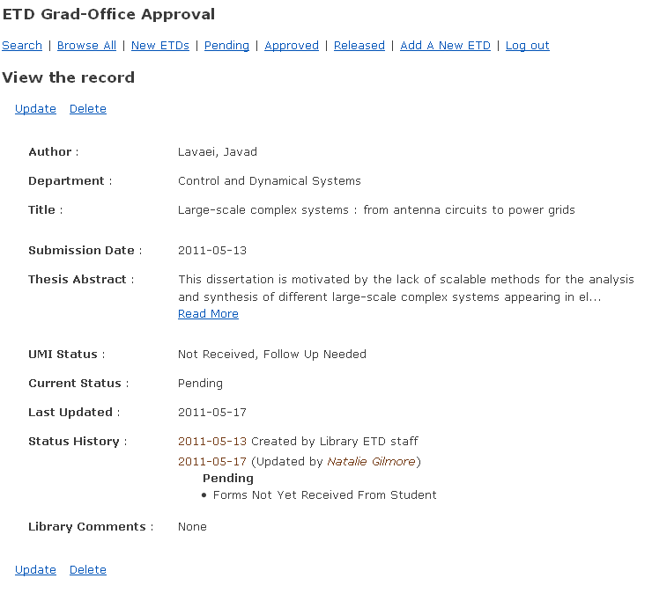

Slide 43
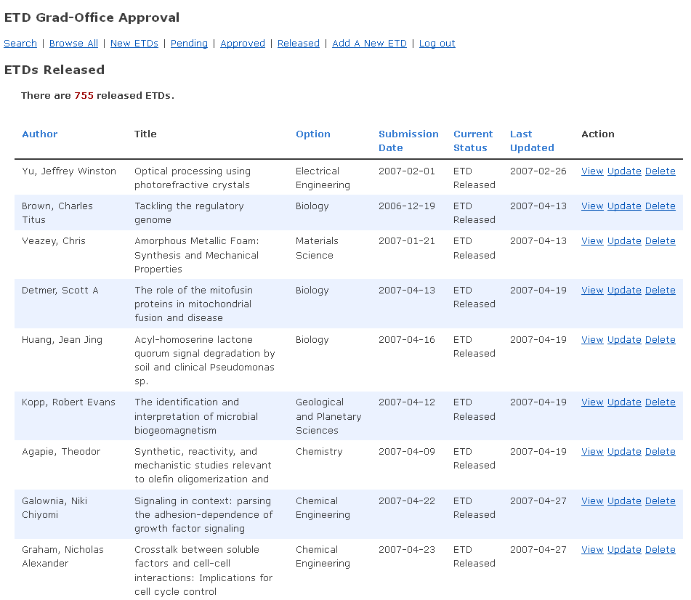

Slide 44
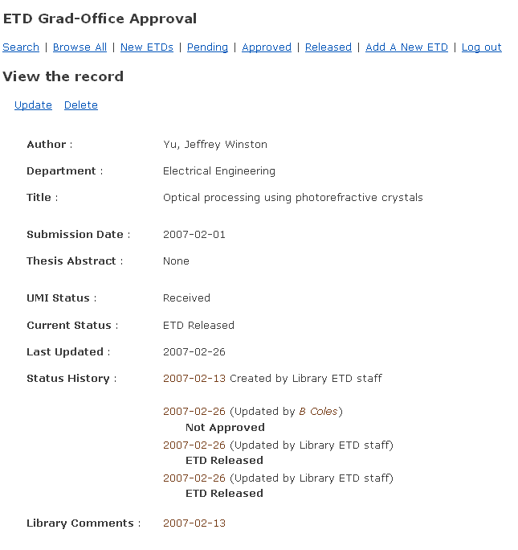

Slide 45
Links
CaltechTHESIS: http://thesis.library.caltech.edu
Web guide for student submitters: http://libguides.caltech.edu/theses
CaltechTHESIS stats reports: http://thesis.library.caltech.edu/stats.html
CODA: http://libguides.caltech.edu/CODA
Caltech Library Services: http://library.caltech.edu/

Slide 46
Contact Information
Katherine Johnson
Digital Repositories Coordinating Librarian
California Institute of Technology
kjohnson@library.caltech.edu
(626) 395-6065

